Slide 1
National Schools Twenty20 competition
Finals day June 29th 2017
Arundel Castle

Slide 2
Photographs by Patrick Eagar
© No images may be reproduced without permission

Slide 3
The first semi-final
Shrewsbury v Millfield
Shrewsbury in dark blue
Millfield in light blue

Slide 4
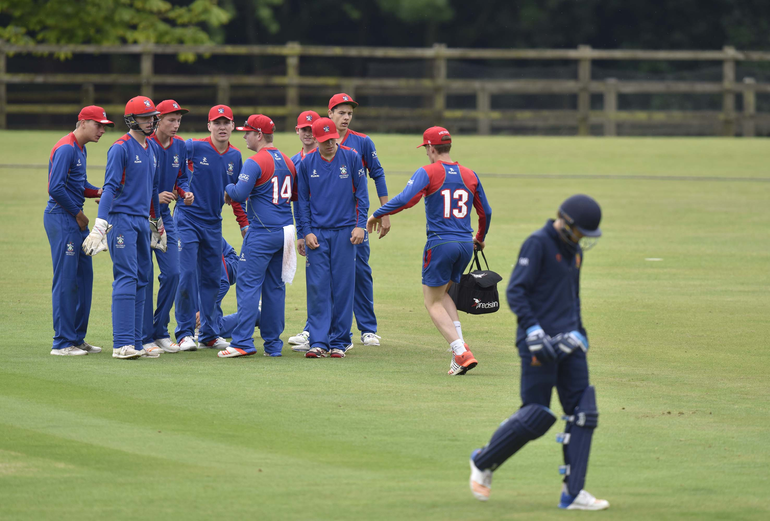
George Garrett (Shrewsbury) trudges back to the pavilion after being caught by Charles Clist off the bowling of Max Hancock
Notes:
George Garrett (Shrewsbury) trudges back to the pavilion after being caught by Charles Clist off the bowling of Max Hancock

Slide 5
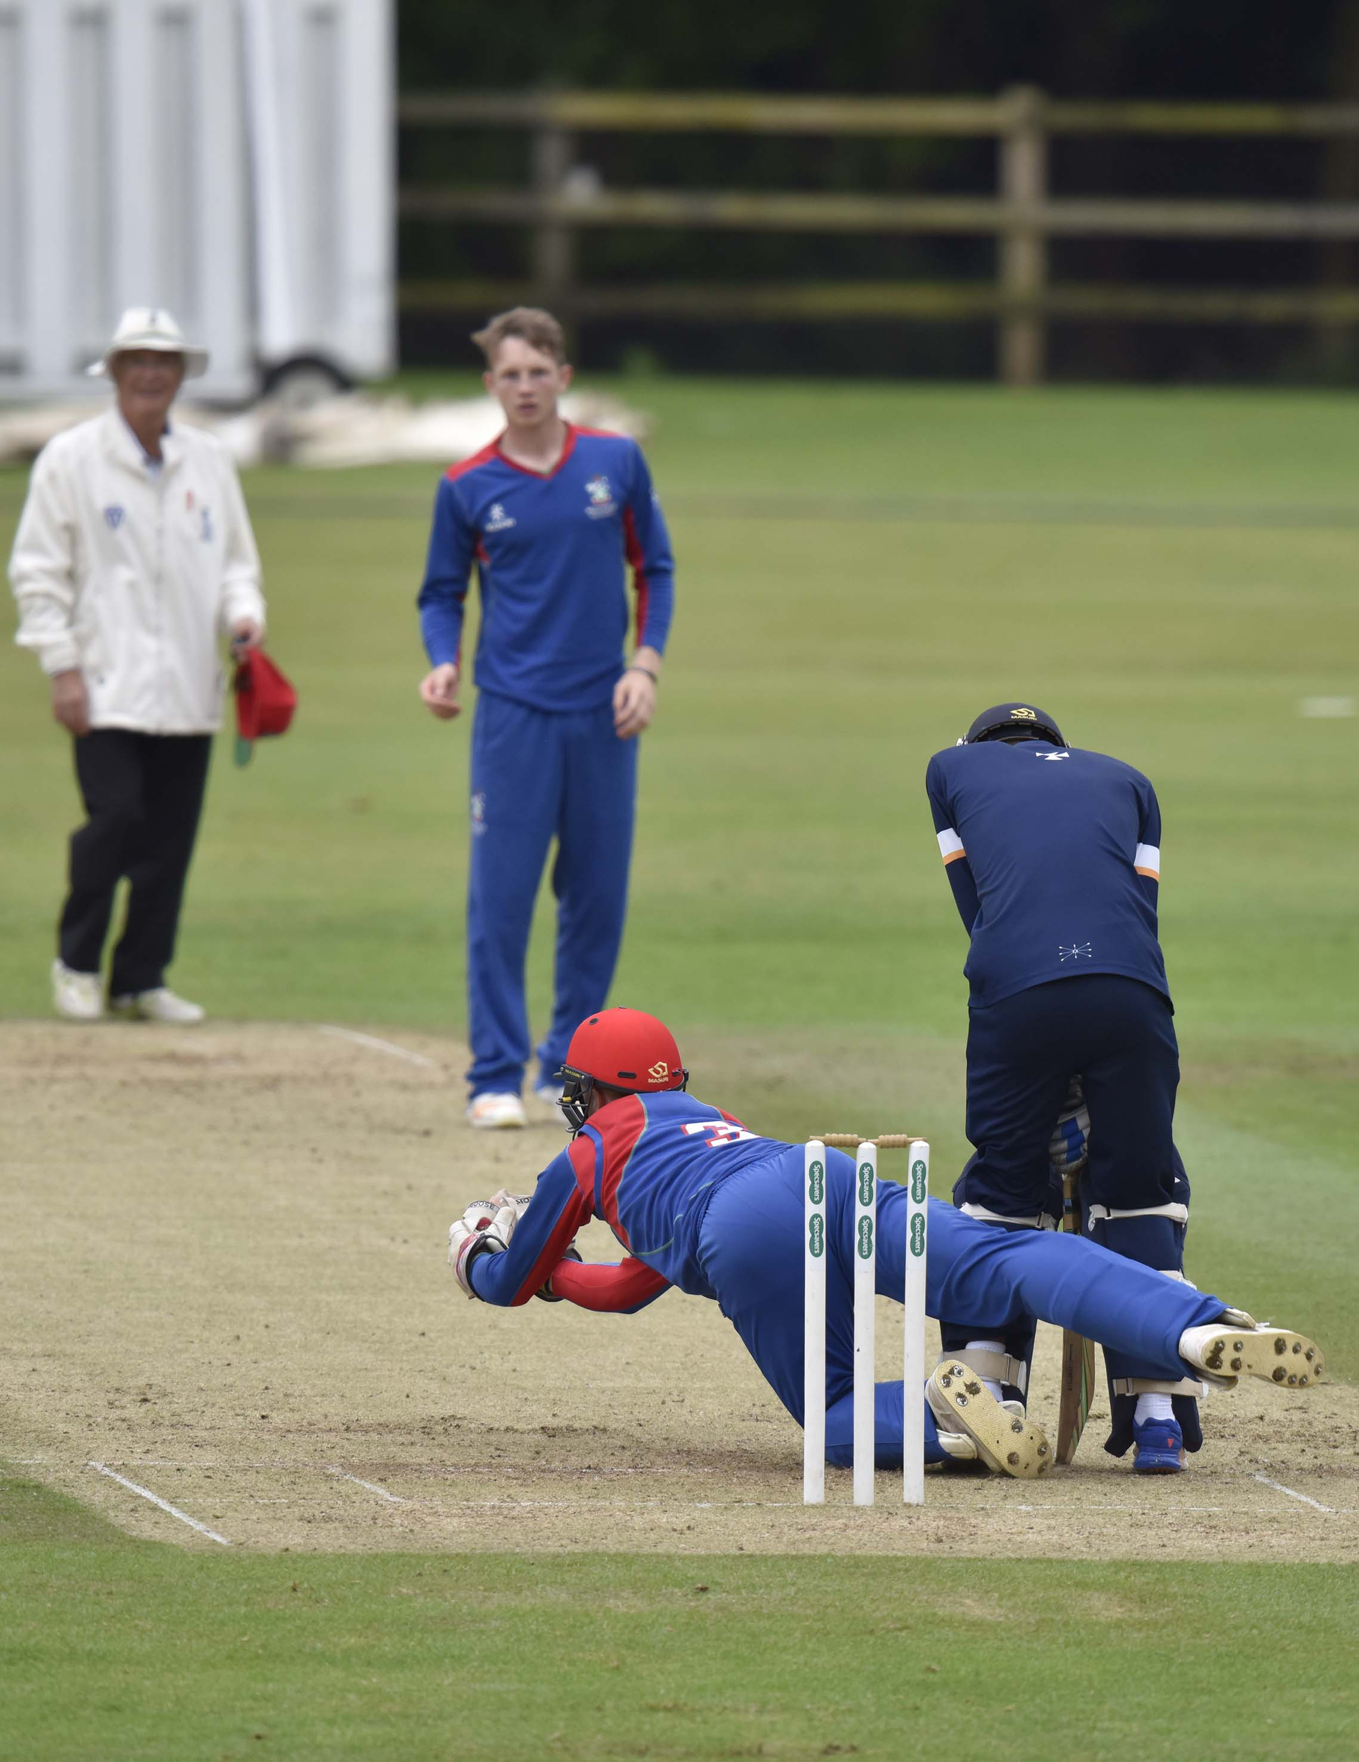
Finlay Trenouth attempts to catch Jordan Zaza of Shrewsbury

Slide 6
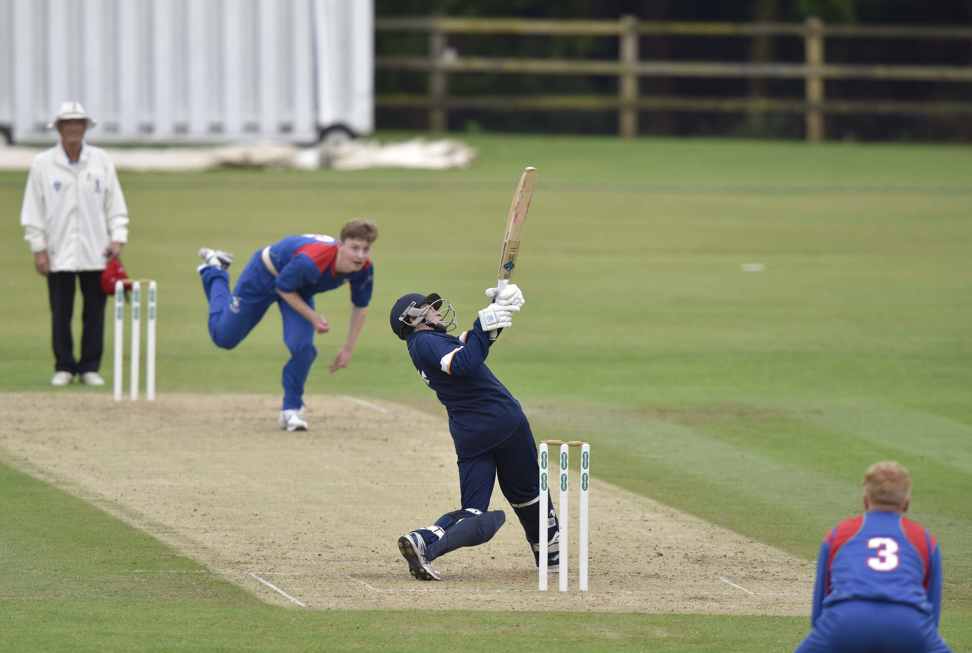
Peter Clark (Shrewsbury) hits Tom Diamond for 6

Slide 7
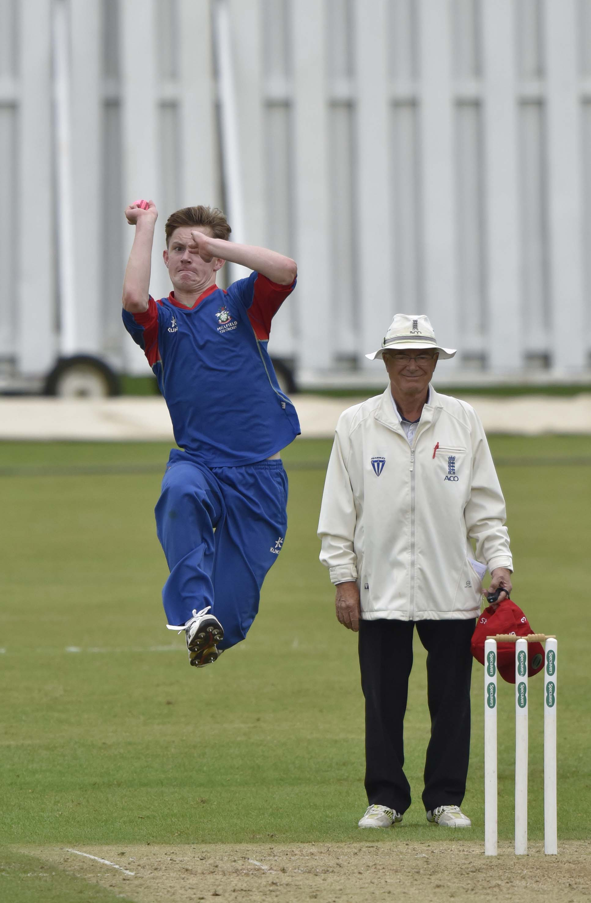
Tom Diamond bowling

Slide 8
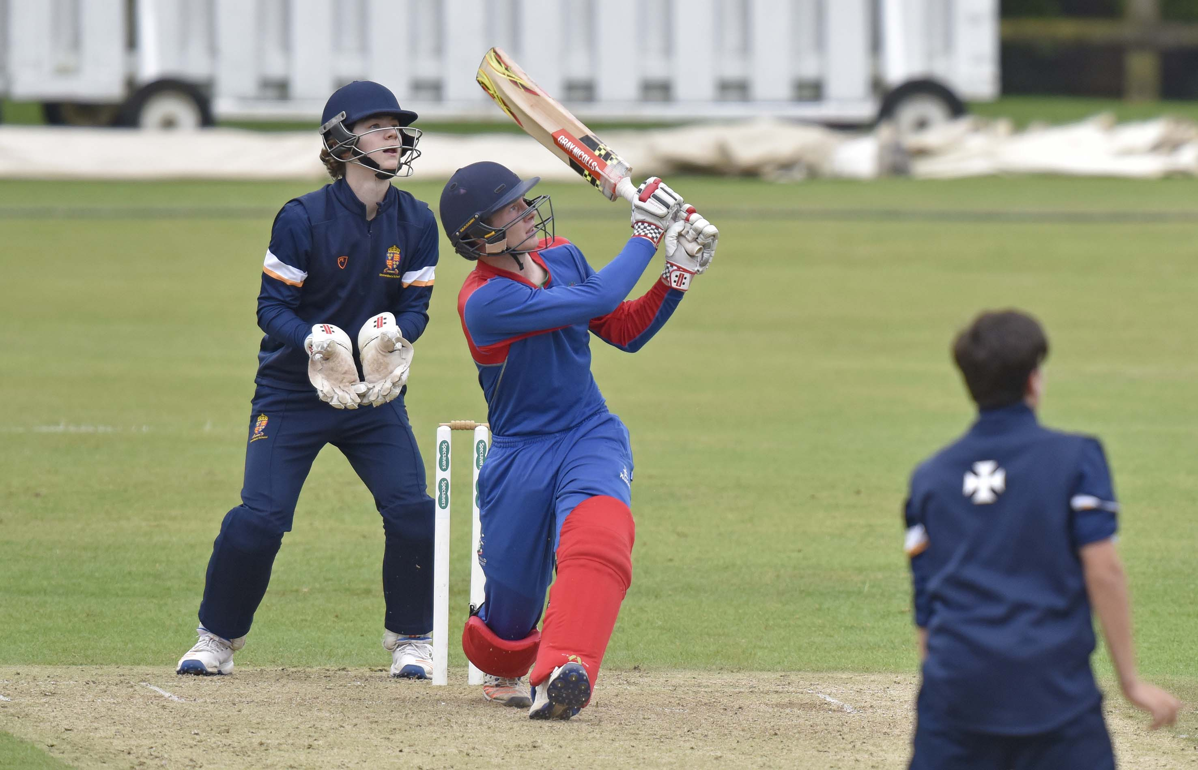
Thomas Bevan hits Peter Clark for 6

Slide 9
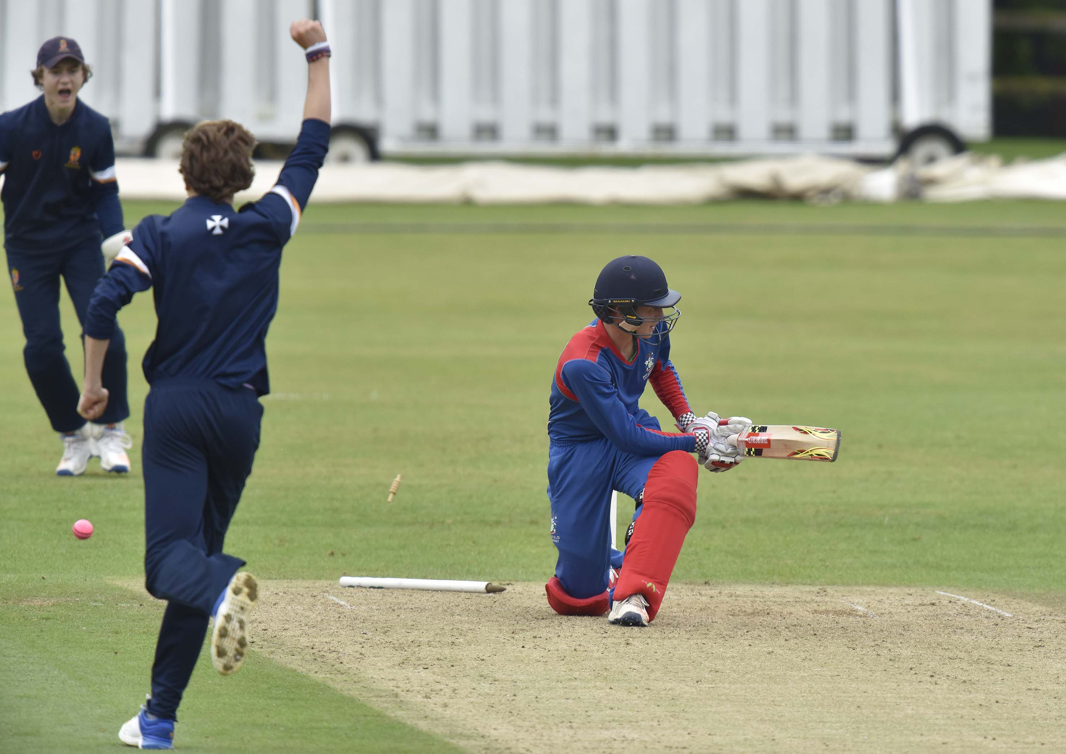
Thomas Bevan (Millfield) is bowled by George Garrett for 55

Slide 10
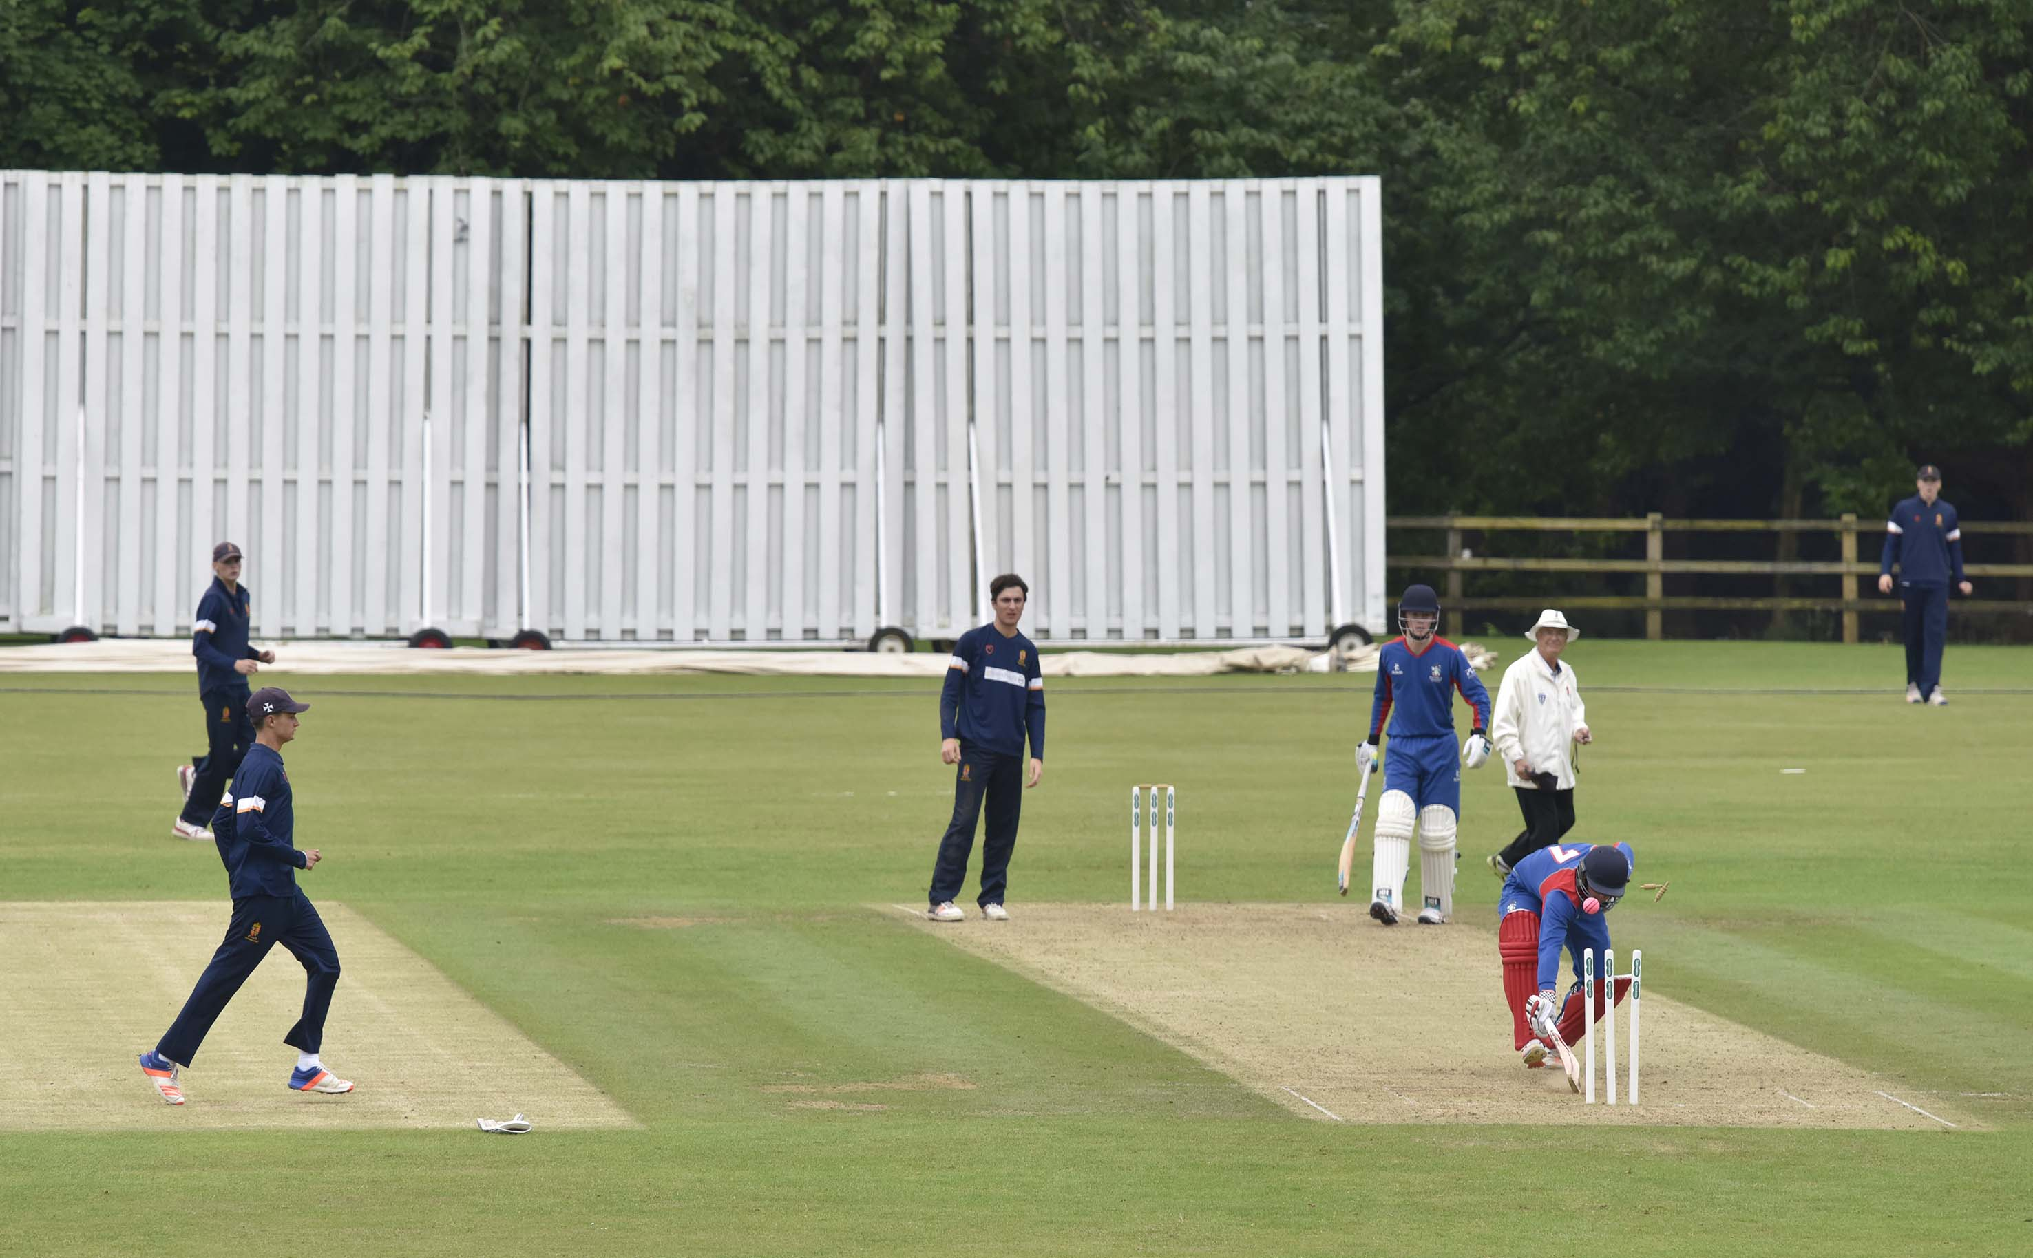
ARUNDEL - JUNE 29: Finals of The National Schools Twenty20 Competition 2017, Shrewsbury v Millfield (first semi-final)

Slide 11
The second semi-final
Sedbergh v Merchnt Taylors’ (Northwood)
Sedbergh in brown
Merchant Taylors’ in dark blue

Slide 12
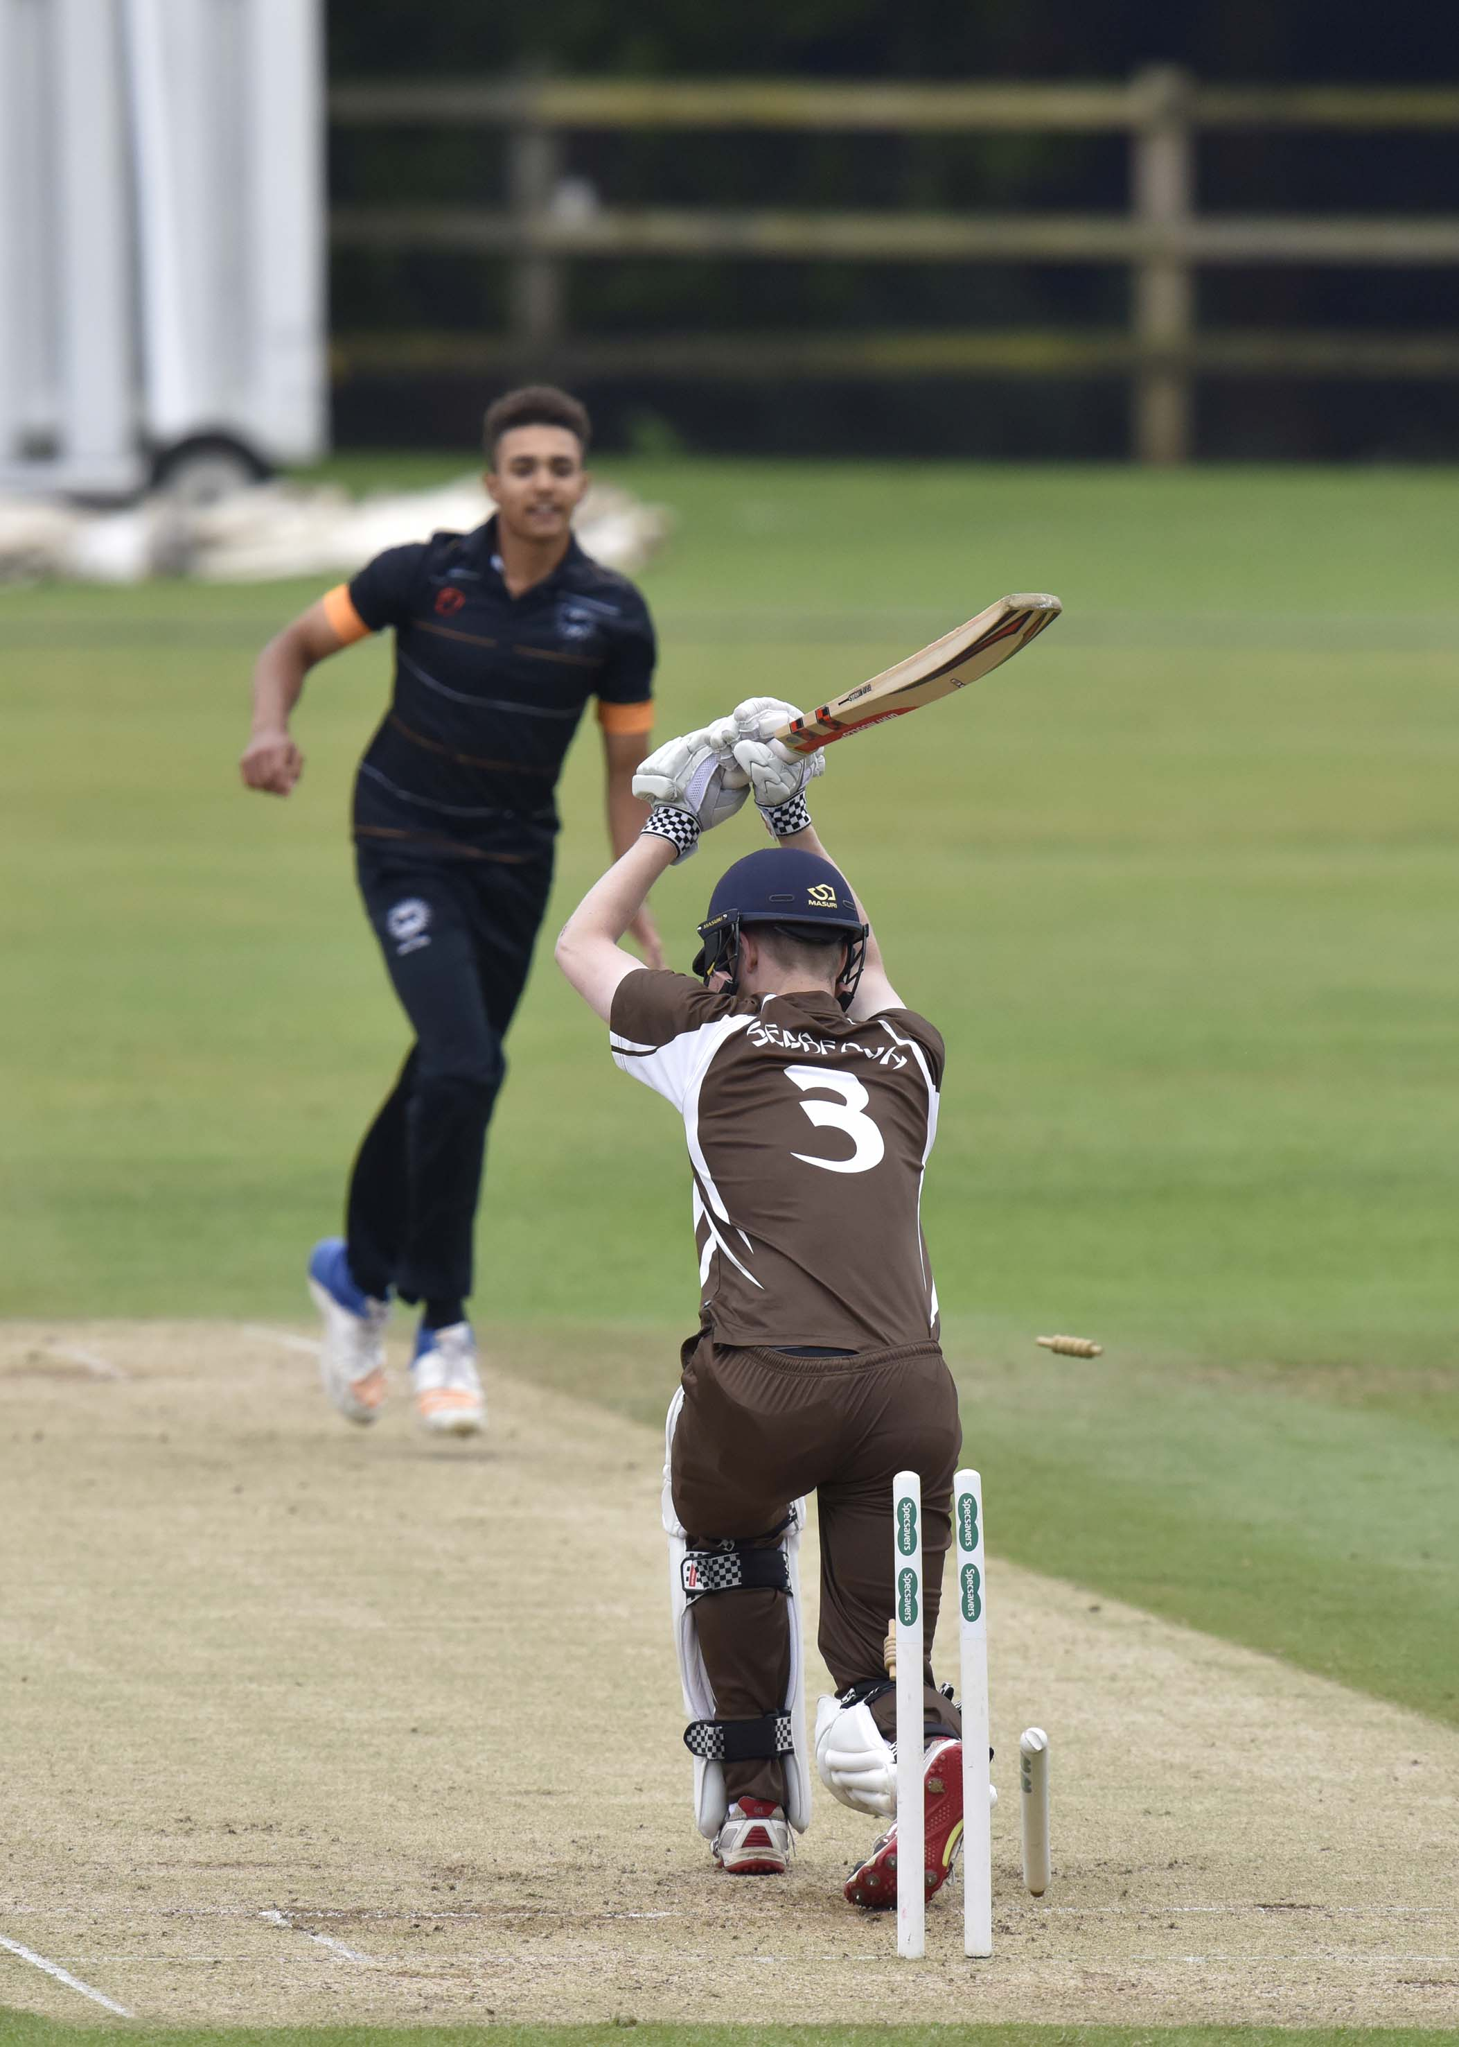
Marcus Stables (Sedbergh) is bowled by Tom Steene.

Slide 13
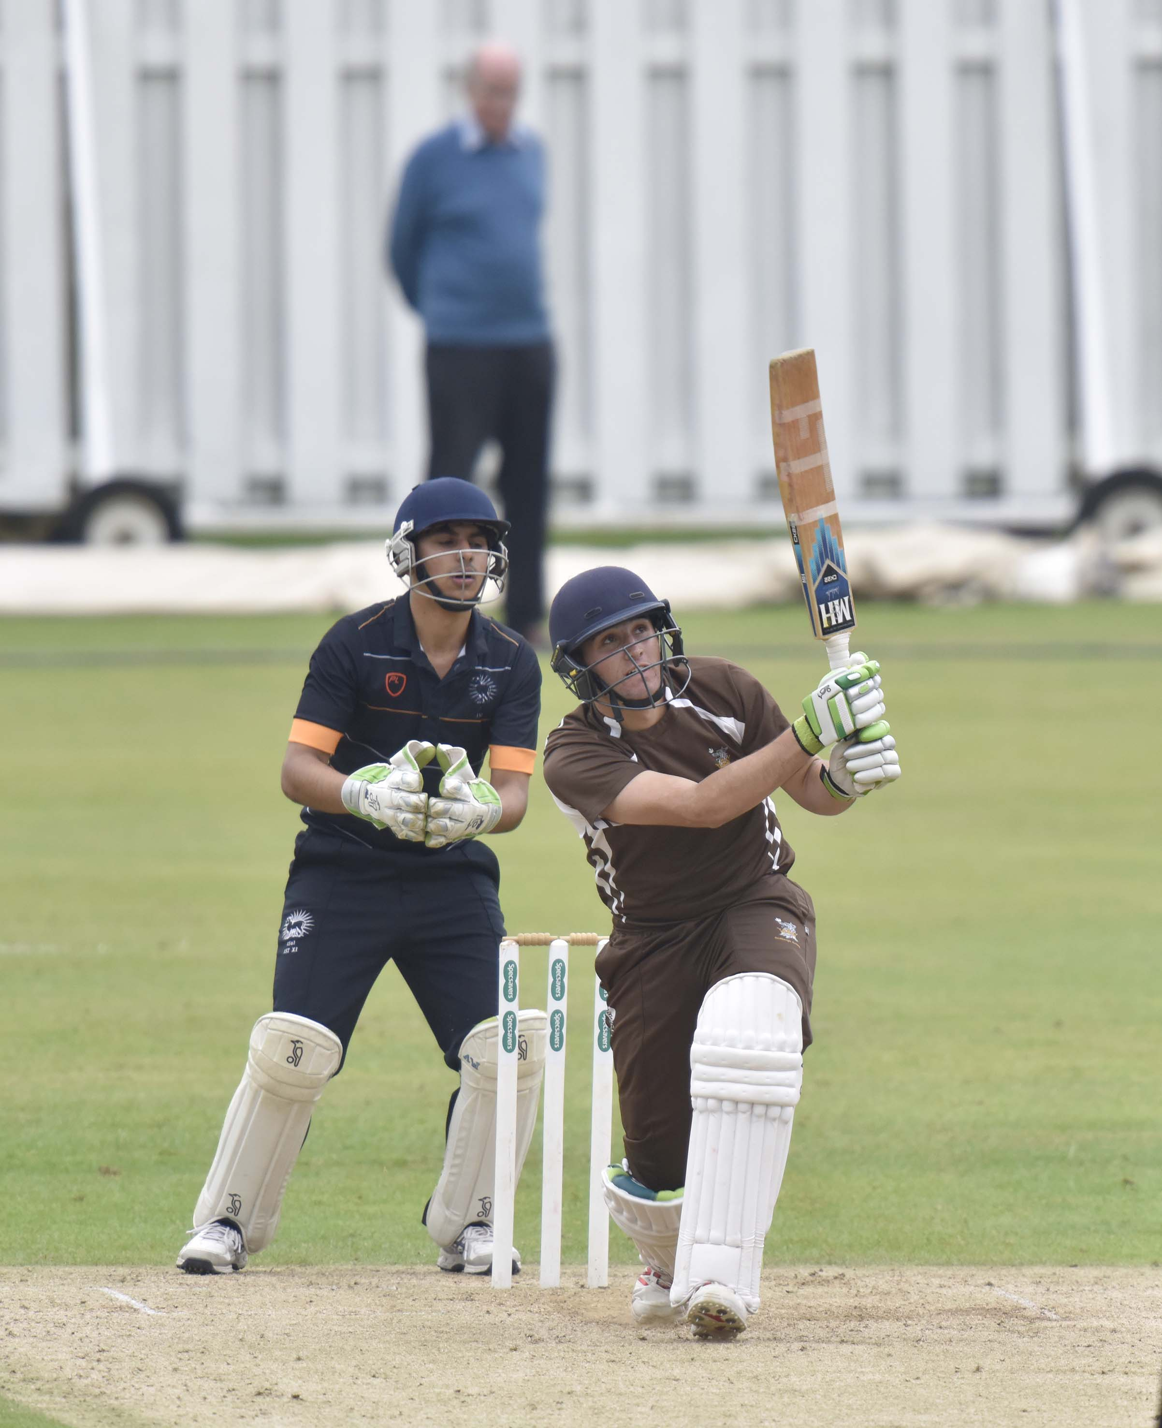
Chris Sander (Sedbergh) drives, watched by tournament organiser Douglas Henderson

Slide 14
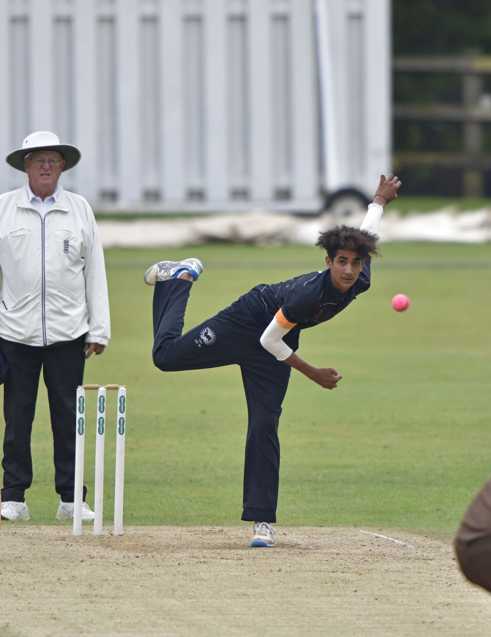
Ashane Wijesuriya bowling; he also kept wicket for the first part of the innings

Slide 15
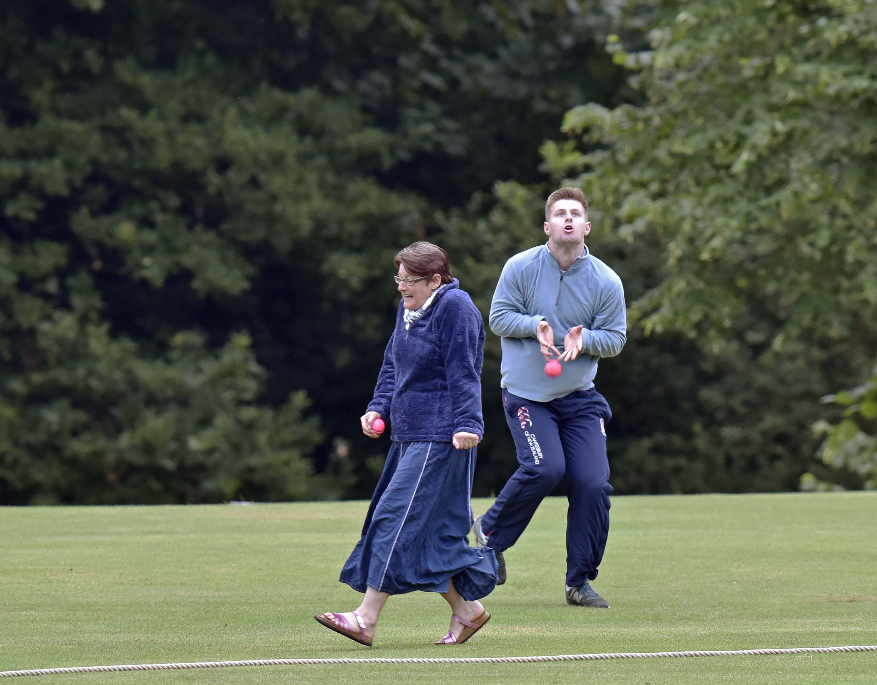
Dropped catch
Patrick Eagar

Slide 16
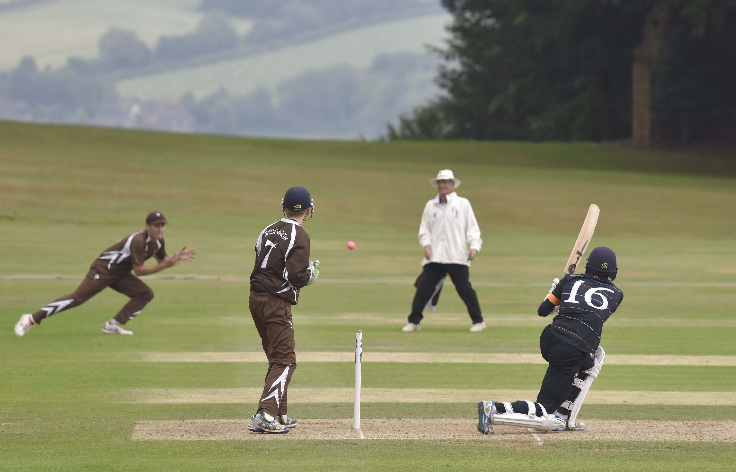
David Burnell is caught by Kyme Tahirkheli off Sam Barrett for 3

Slide 18
The final
Sedbergh v Millfield
Sedbergh in brown
Millfield in light blue

Slide 19
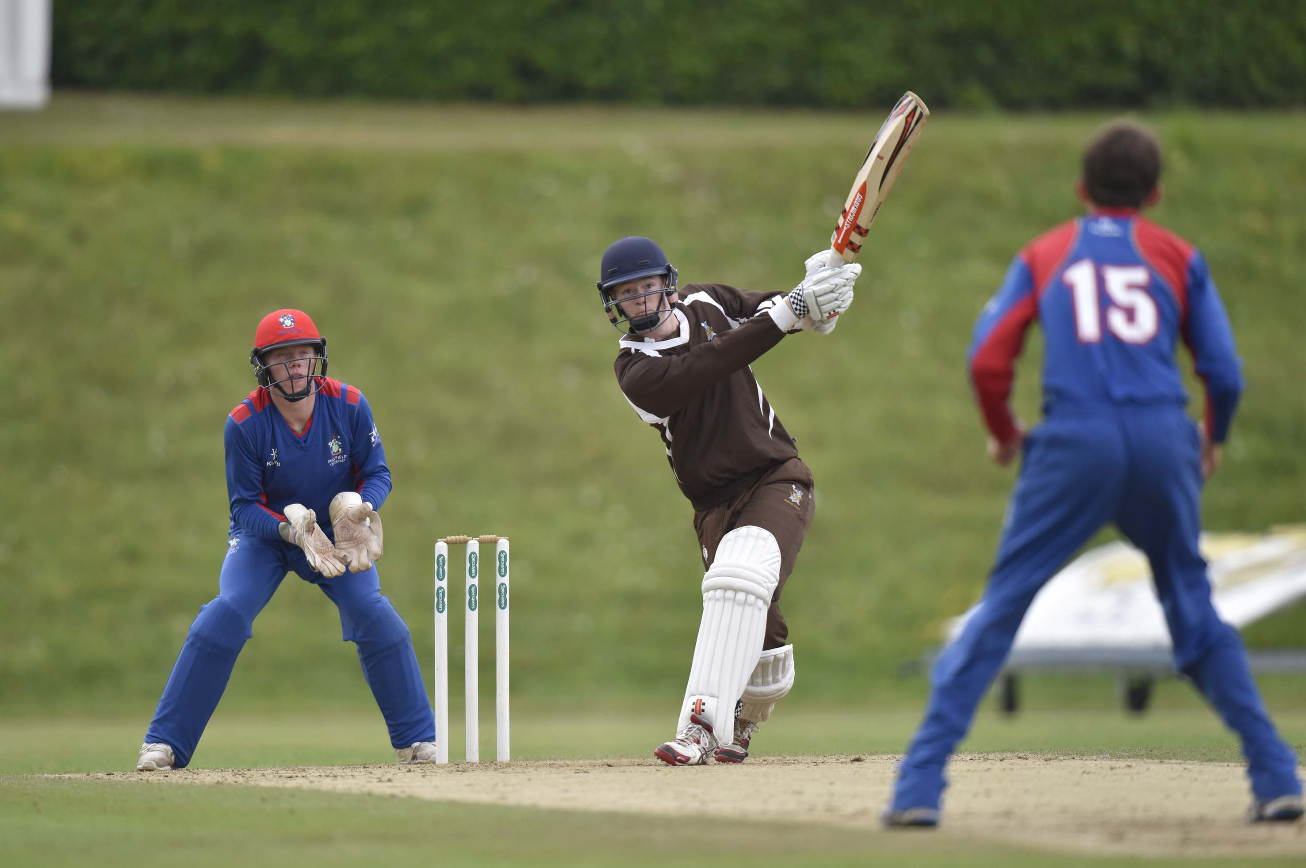
Marcus Stables (Sedbergh) drives Max Hancock (Millfield)

Slide 20
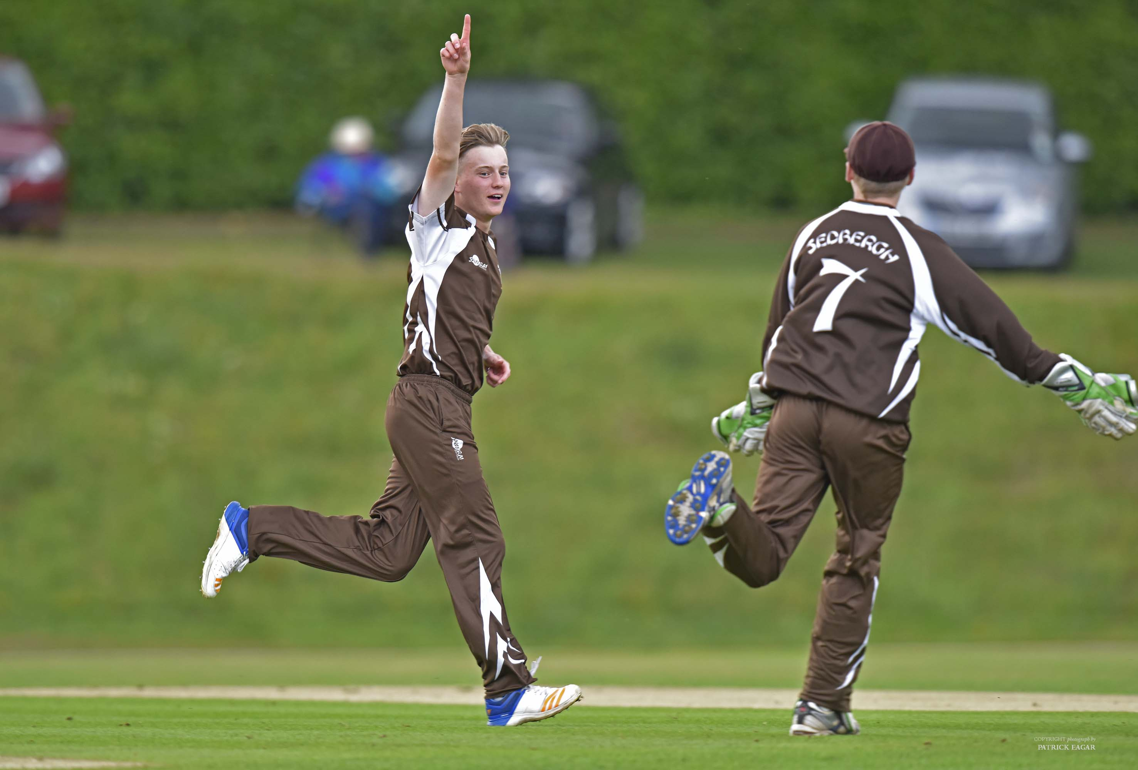
James Park-Johnson celebrates taking his second wicket in his first over

Slide 21
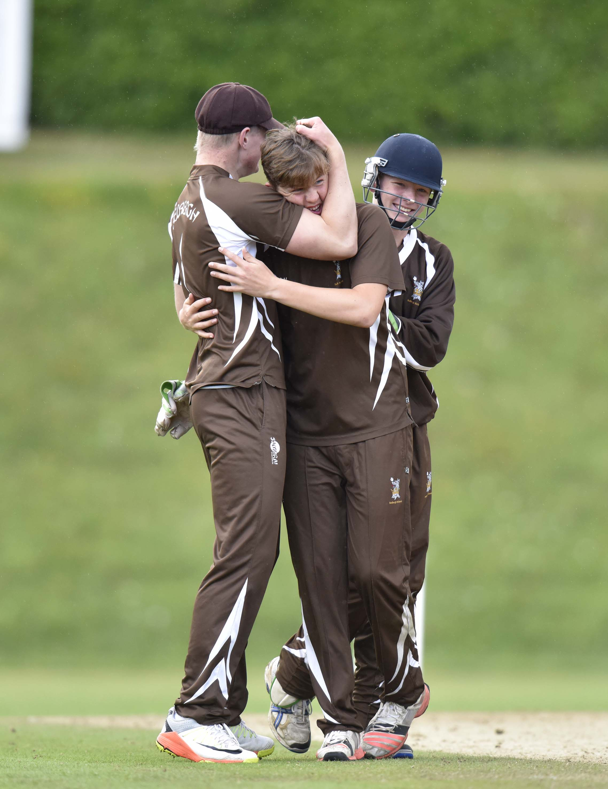
Sedbergh take a wicket.

Slide 22
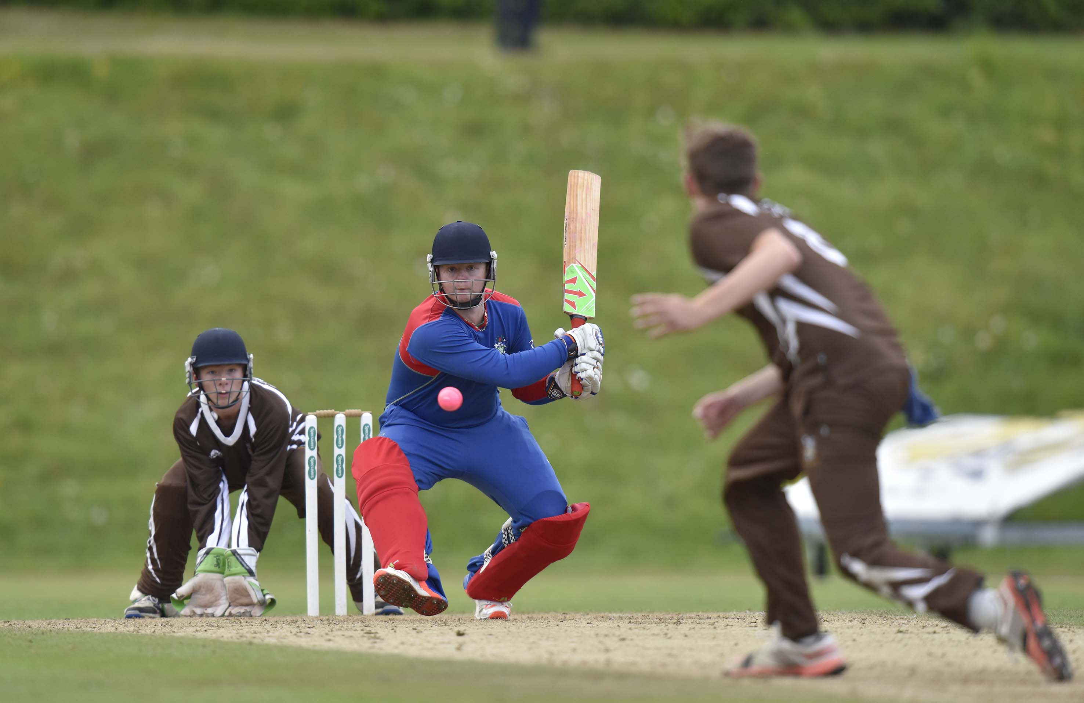
Danny Chesham (Millfield) goes for the reverse sweep

Slide 23
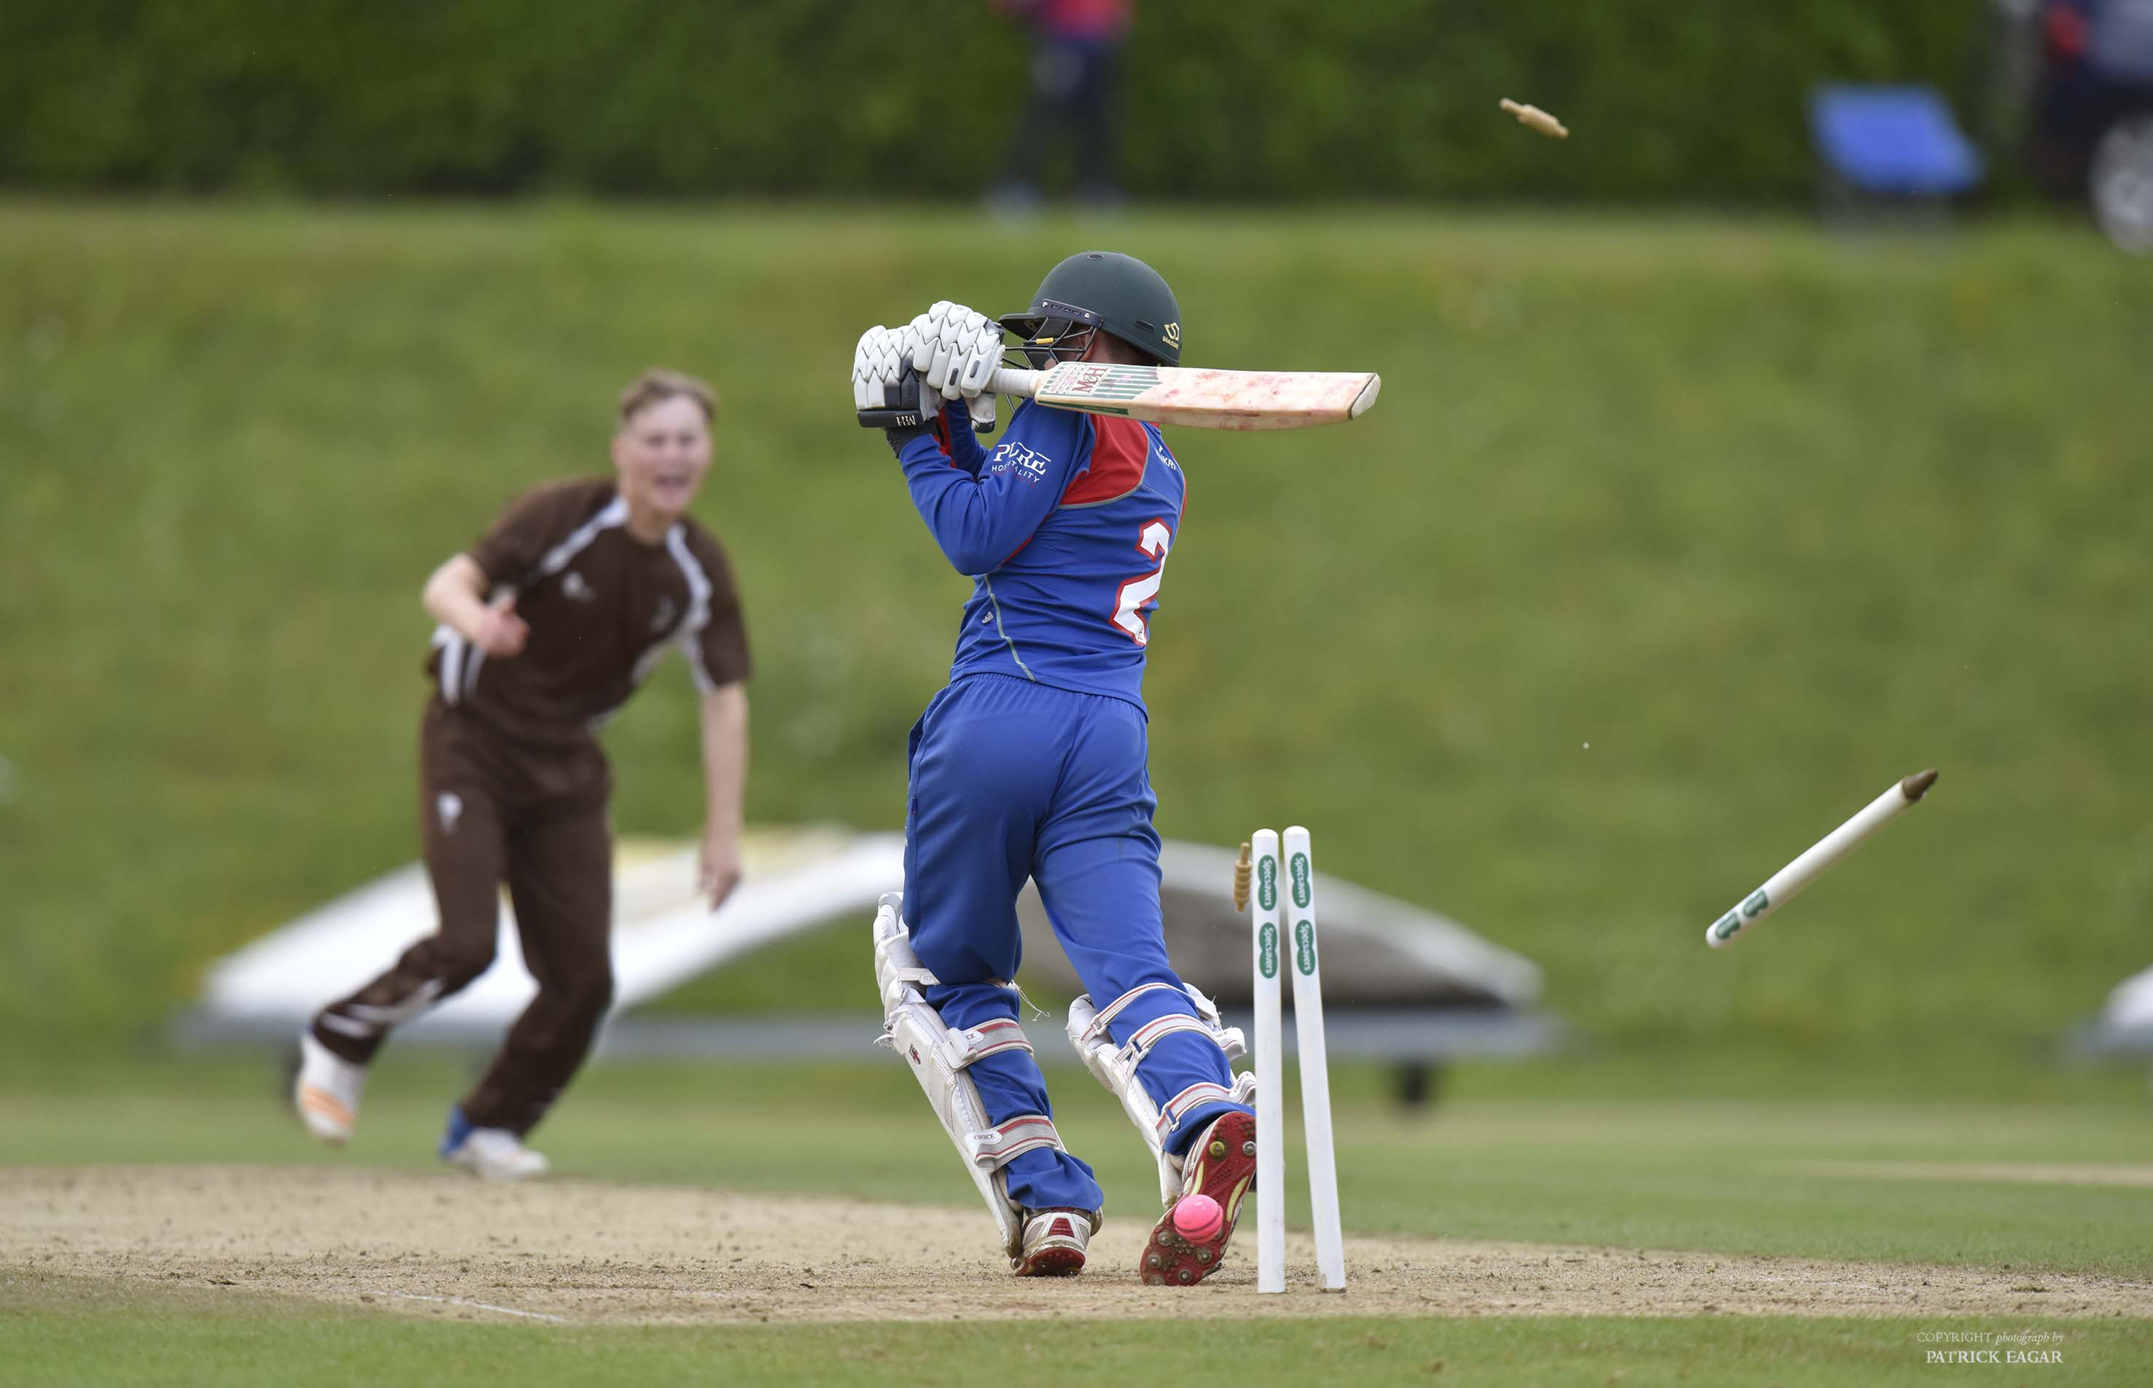
Marcus Critchley is bowled by James Park-Johnson for 3

Slide 24
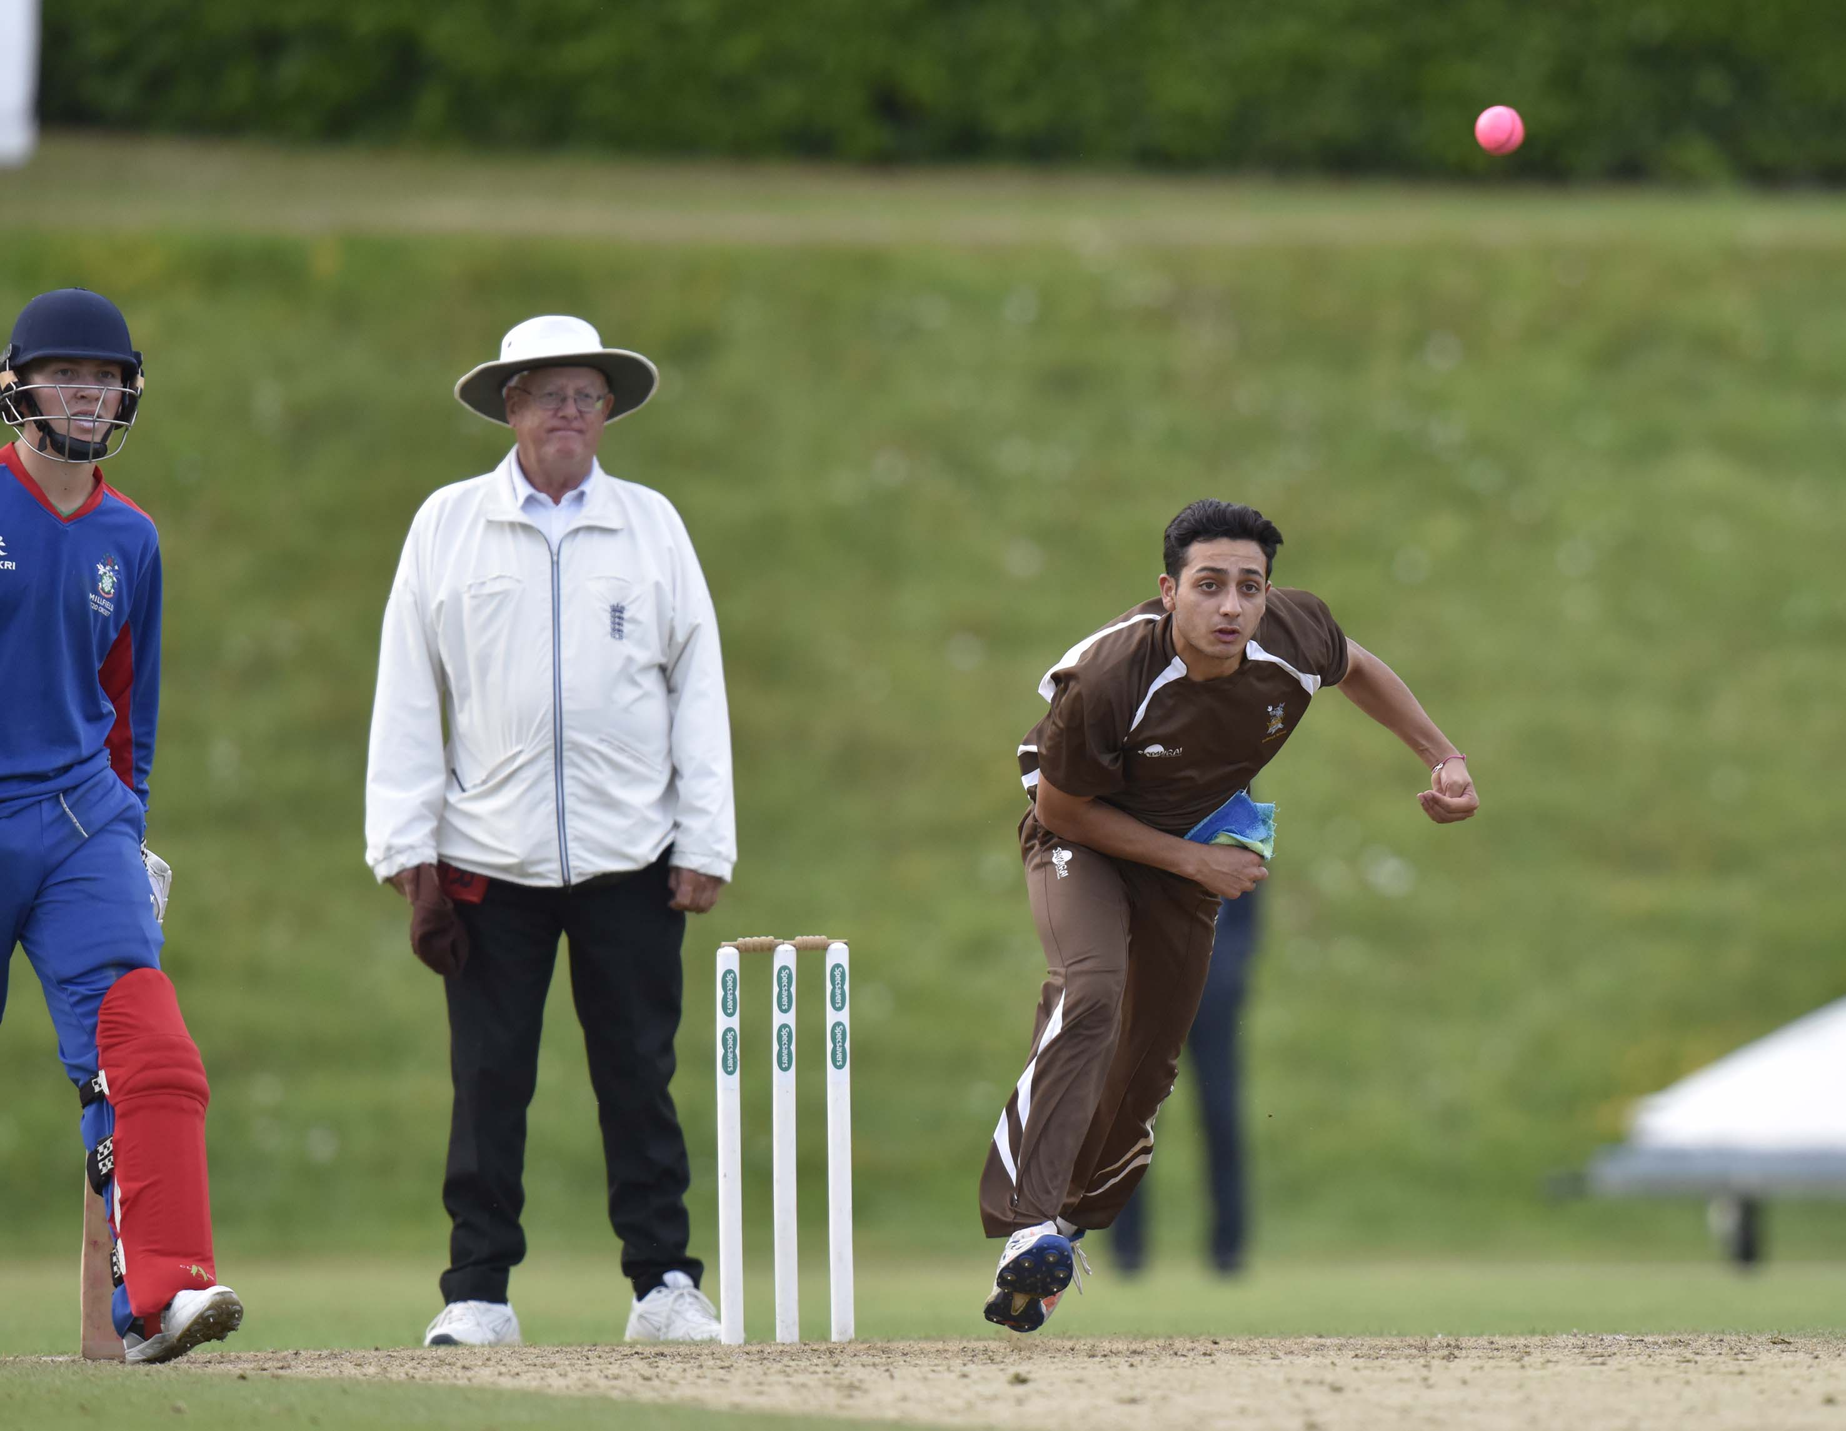
Kyme Tahirkheli (Sedbergh) bowling

Slide 25
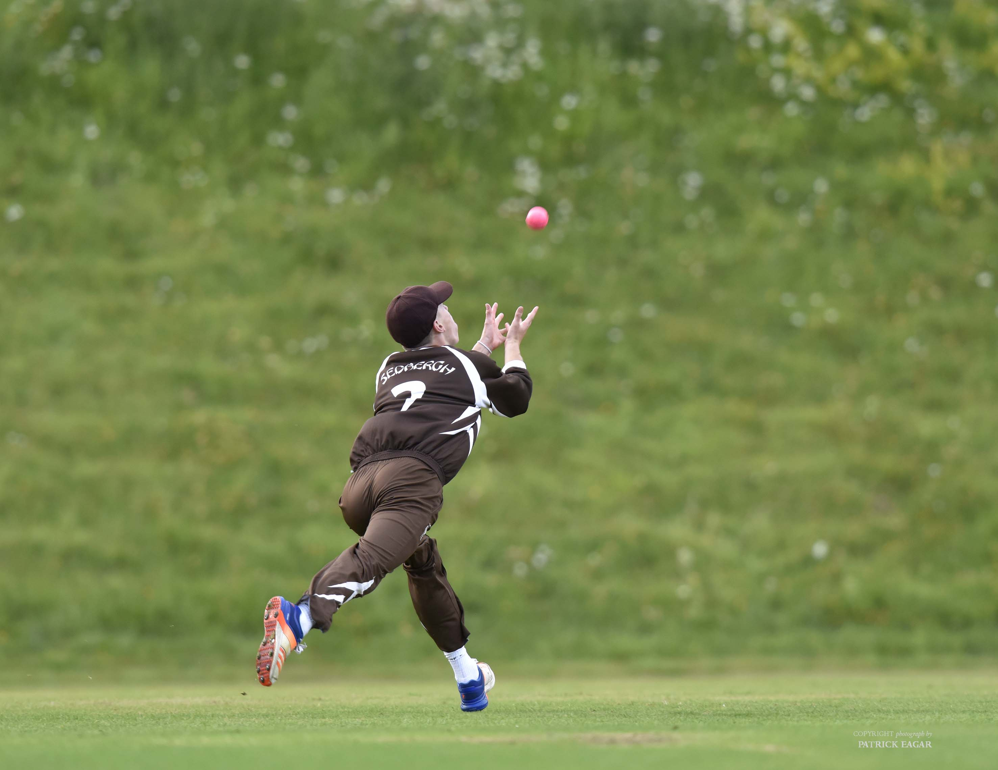
Chris Park-Johnson catches off Kyme Tahirkheli for 12

Slide 26
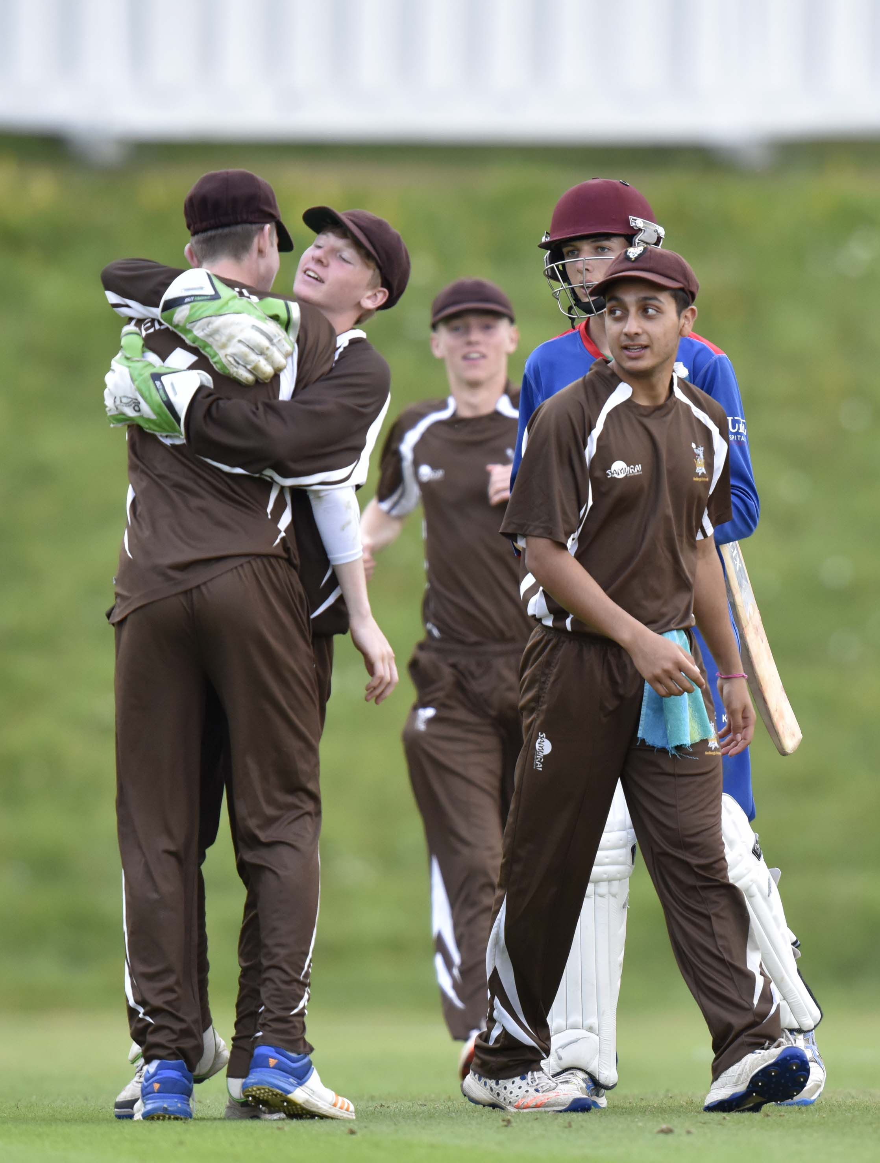
Sedbergh win the final and the tournament.

Slide 27
Presentation of the trophy
Winners 2017: Sedbergh
Johnny Barclay
Formerly captain of Sussex CCC & MCC President
Introduction
Douglas Henderson

Slide 28
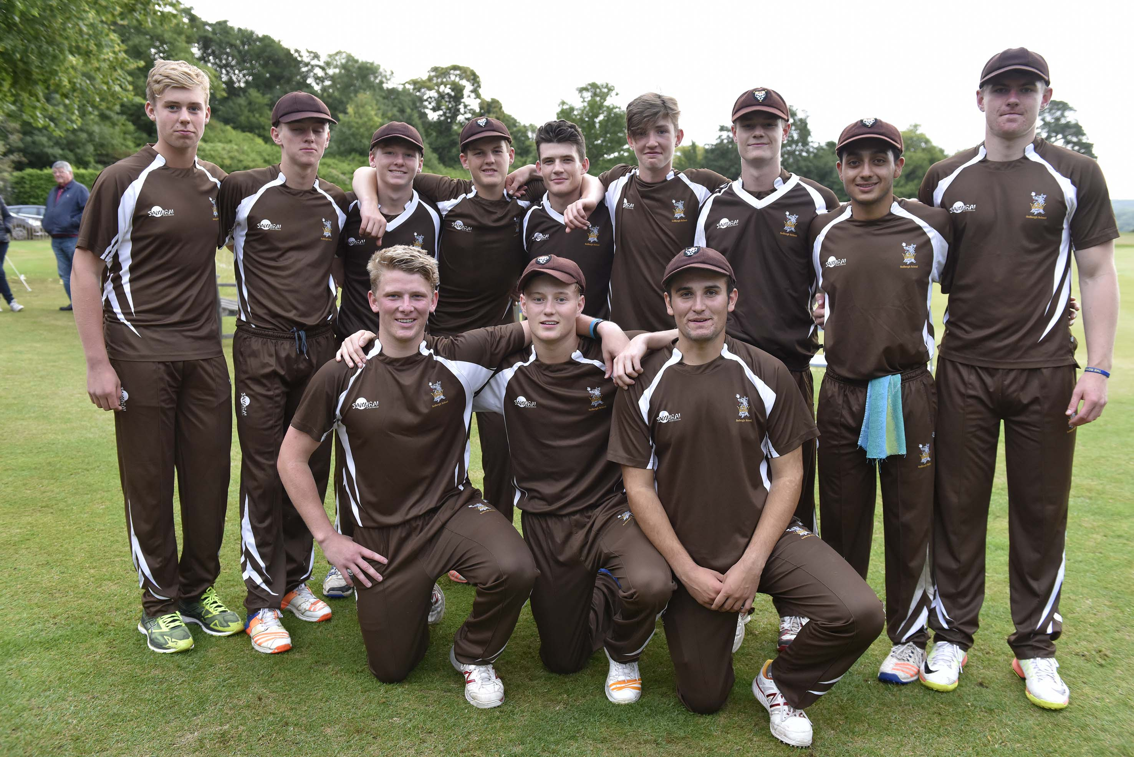
Sedbergh, National Schools Twenty20 champions 2017

Slide 29
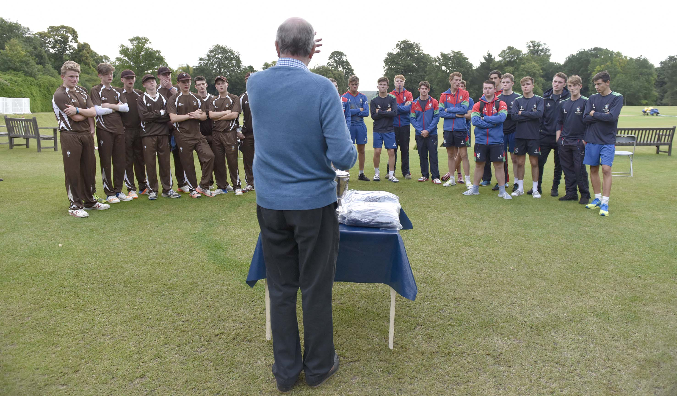
The finalists being addressed by tournament organiser Douglas Henderson

Slide 30
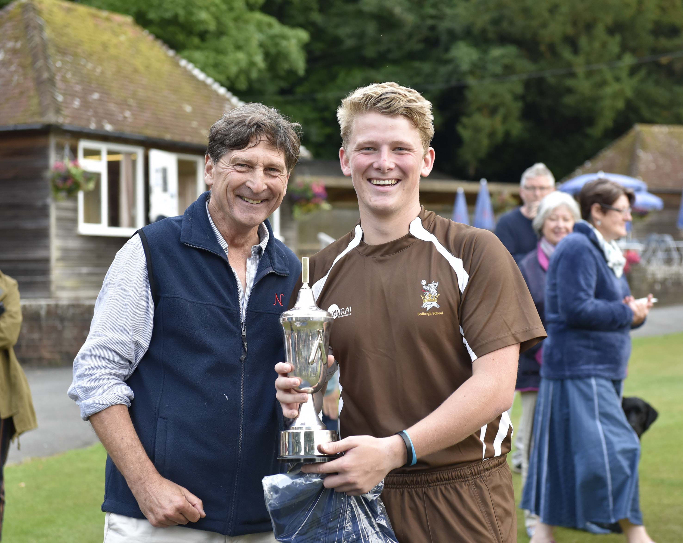
Johnny Barclay presents Harry Brook with the Trophy

Slide 31
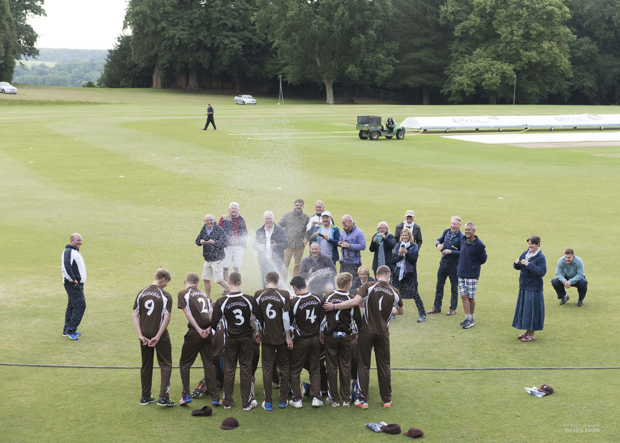
Sedbergh celebrate their victory in style

